Slide 1
July 24th, 2024

Slide 2
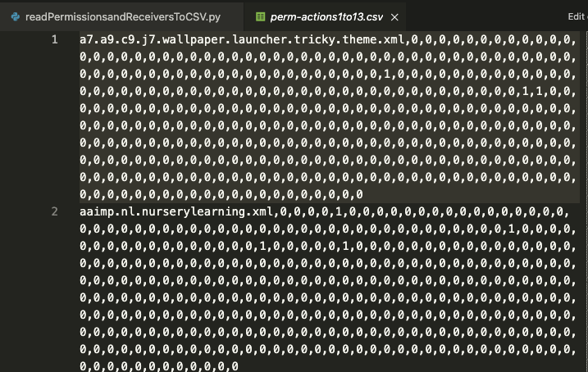
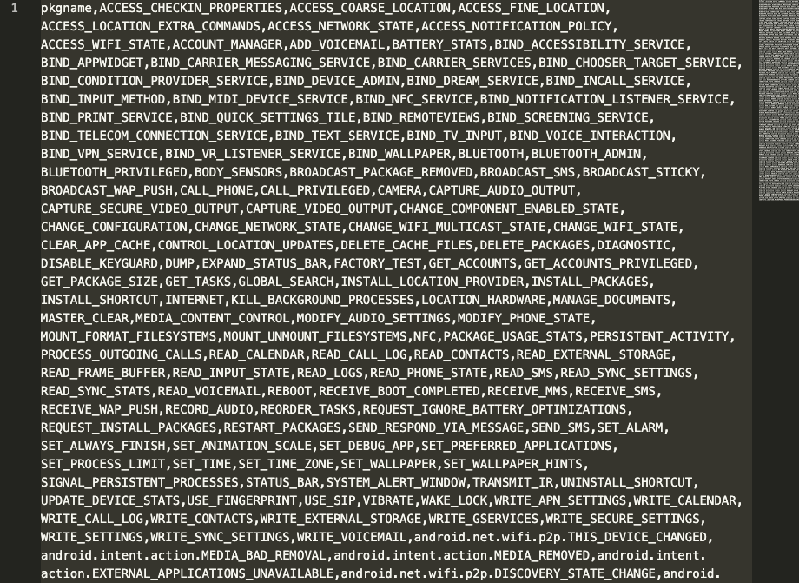
readPermissions.py script troubleshooting
Purpose: Figure out why some of the permission columns are all zero (they shouldn’t be)

Slide 3
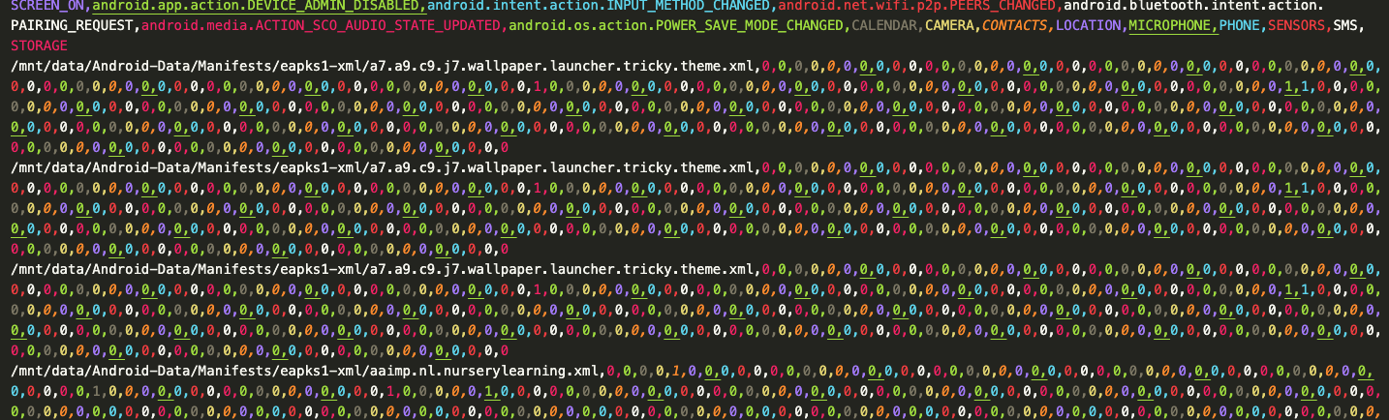
So far, in the eapks1 directory, it looks like SMS, STORAGE, and SENSORS are all zeros. I need to figure out a way to confirm that’s true without decoding each xml file manually

Slide 4
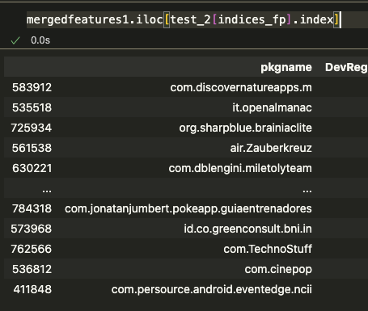
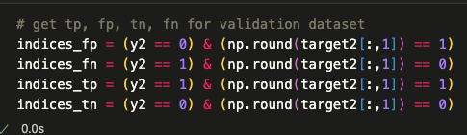
Getting true pos., false neg., etc. from Main.py
Purpose: Determine why the model is failing/succeeding where it is
Should I clarify if the app was in the training set, validation set, or testing set?

